Slide 1
UNIT V :Optimization problems as search problems
Dr N.Subhash Chandra Department of Computer Science,
CVR College of Engineering, Hyderabad

Slide 2
OUTLINE
LECTURE 7 : Randomized algorithms-P Problem, tractable algorithms
Back Tracking
N-Queens problem
Graph coloring
Subset-sum modeling
Branch and Bound- introduction Data structure support
Travelling Salesperson Problem(TSP)
Randomized algorithms- P- problems, tractable algorithms
Definition of different NP problems.
05-Jan-21
2

Slide 3
Introduction
⚫ Many real world problems are intractable problems. An intractable problem is a problem that requires more computer resources such as space and time. But, these problems cannot be ignored as one encounters these problems in daily life. For example, problems like scheduling or weather forecasting are hard problems. Hence, there is a necessity to explore alternative ways to solve these problems. One such approach for attempting to solve difficult problems is randomized algorithms. Another approach is approximation algorithms. Let us discuss about randomized algorithms now.
05-Jan-21
3

Slide 4
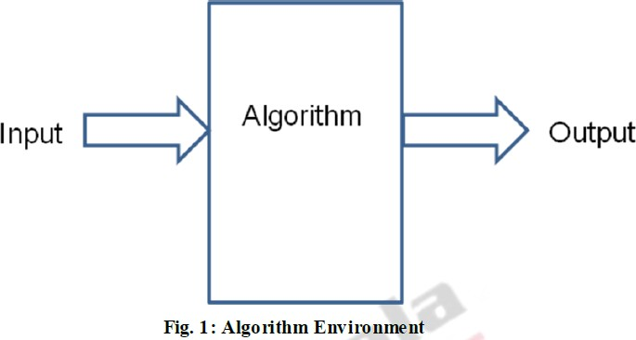
Deterministic Algorithms
Algorithms can be classified into deterministic algorithms and randomized algorithms. Algorithms with the property that “the result of every operation is uniquely defined” is called deterministic algorithm is shown in Fig 1.
05-Jan-21
4

Slide 5
Randomized Algorithms
What is randomness? Randomness is a state of the system whose behaviour follows no deterministic or predictable pattern. Some of the daily encounters like gambling, puzzles, decision making process and heuristics are examples of randomness. Randomness is used as a computing tool by randomized algorithms for algorithm design.
Randomized algorithms are also called probabilistic algorithms or nondeterministic algorithms.

Slide 6
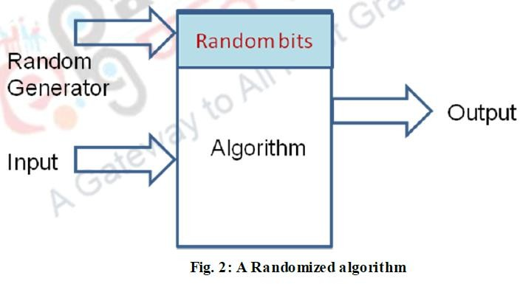
Randomized Algorithm
⚫ It should be noted that randomized algorithms output is based on random decisions and
its output
is based on There would be
probability.
negligible errors on the long run.
⚫ Randomized Algorithms are dependent on inputs and use random choices as part of the logic itself is shown in Fig 2.

Slide 7


What are the advantages of randomized algorithms?
Some of the advantages of randomized algorithms are given below:
Known for its simplicity very Efficient
Computational complexity is better than deterministic algorithms
Some of the disadvantages of randomized algorithms are as given below:
Reliability is an issue
Quality is dependent on quality of random number generator used as part of the algorithm

Slide 8
Quick Sort
Select: pick an arbitrary element x in S to be the pivot.
Partition: rearrange elements so that elements with value less than x go to List L to the left of x and elements with value greater than x go to the List R to the right of x.
Recursion: recursively sort the lists L and R.

Slide 9
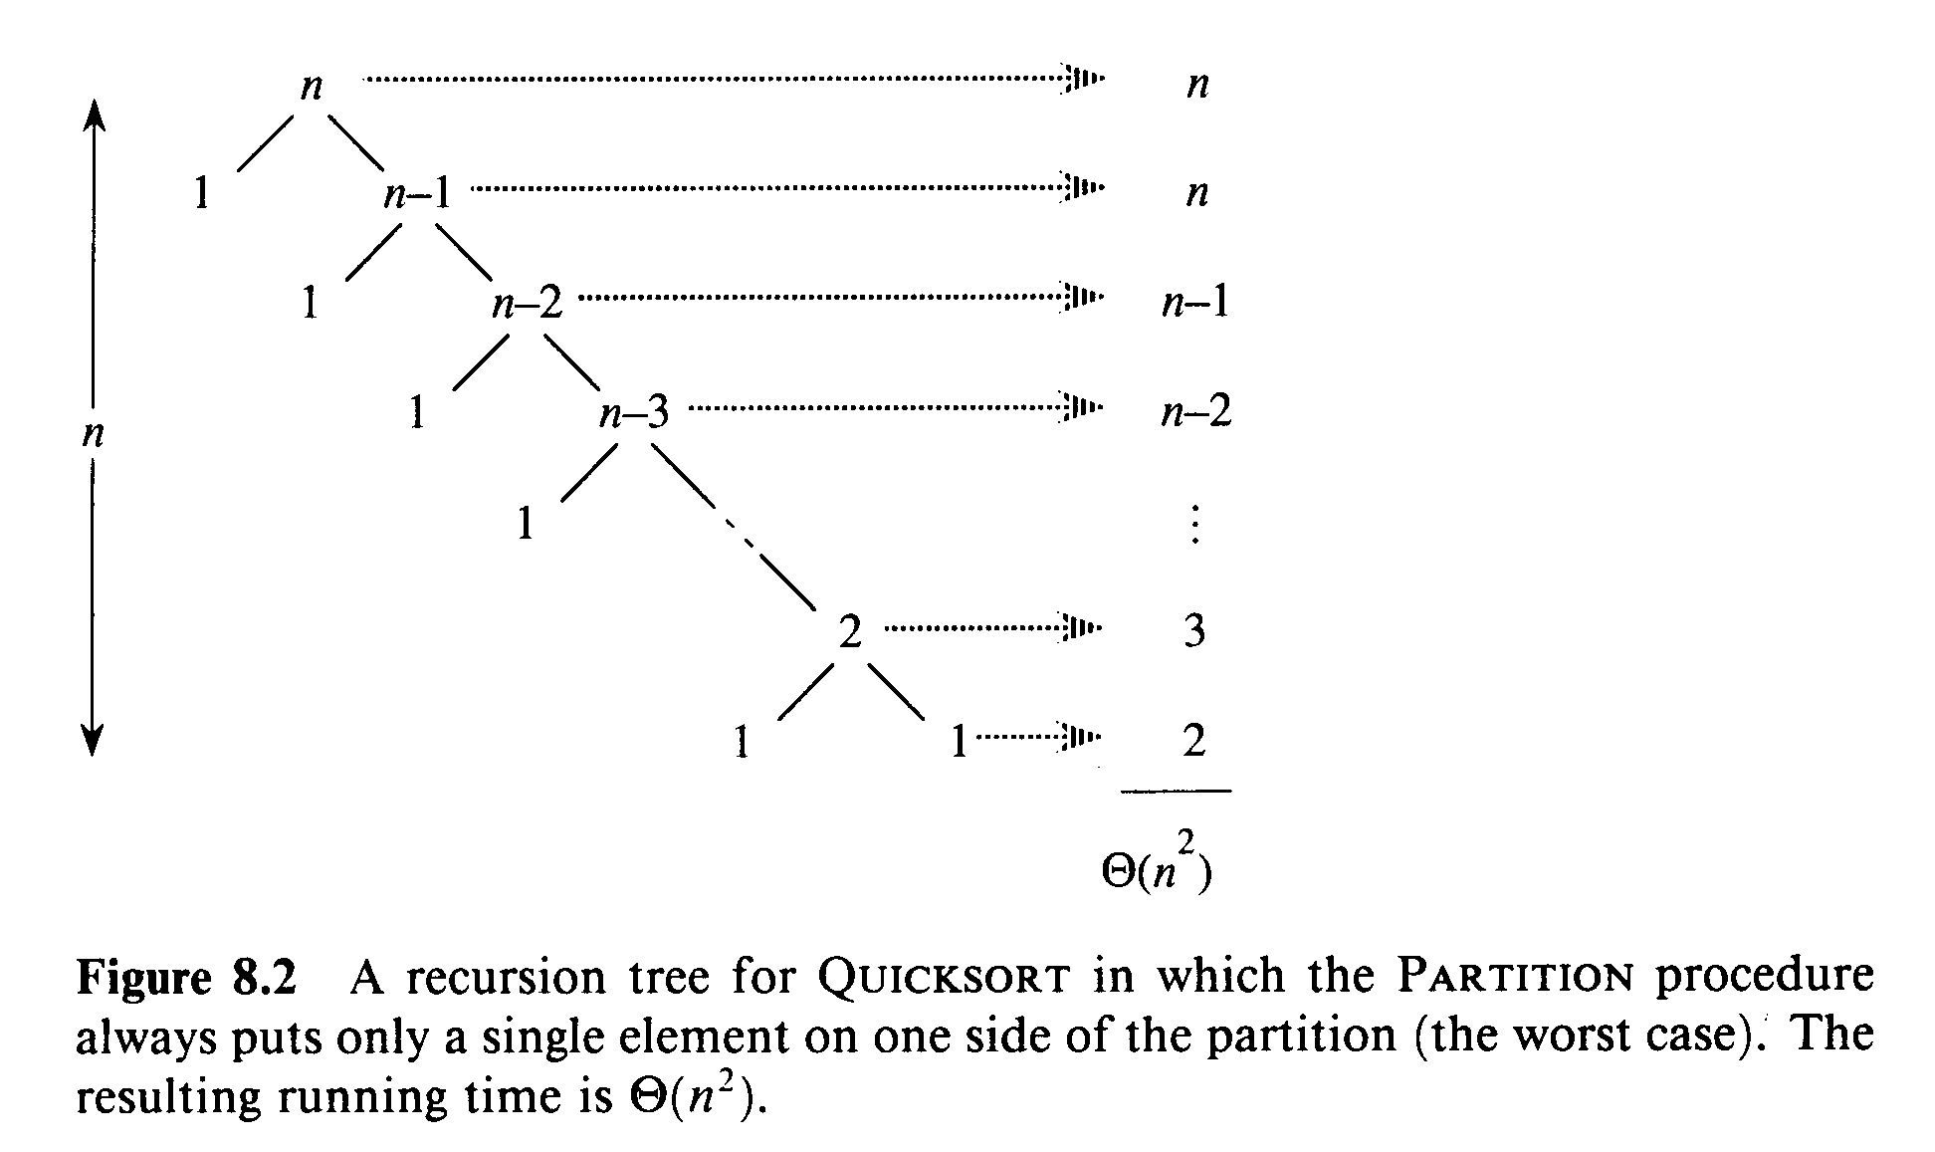
Worst Case Partitioning of Quick Sort

Slide 10
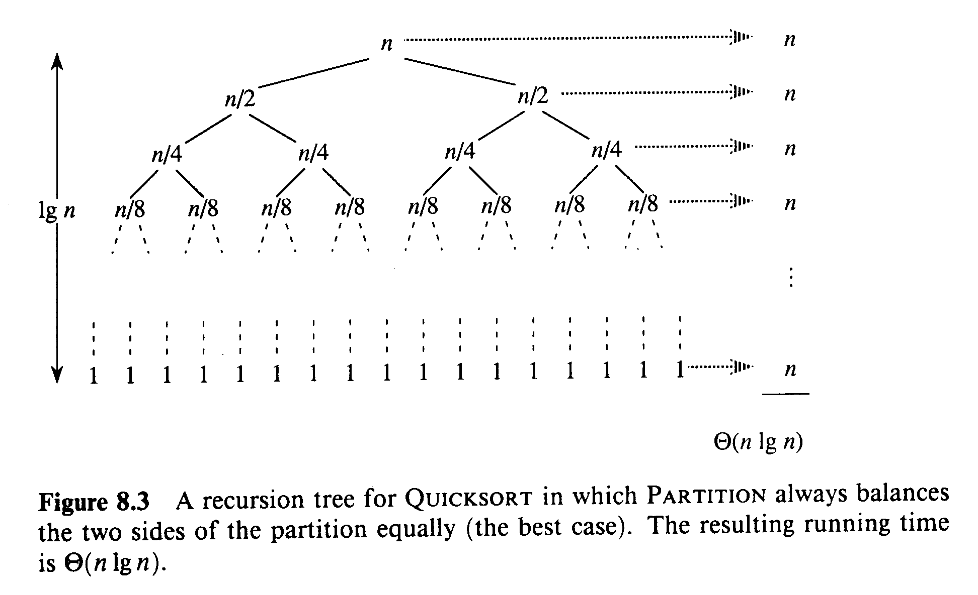
Best Case Partitioning of Quick Sort

Slide 11
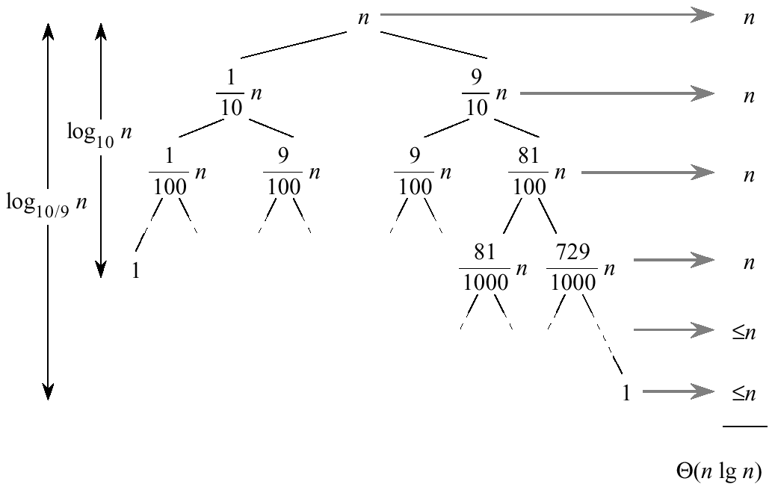
Average Case of Quick Sort

Slide 12
Randomized Quick Sort
Randomized-Partition(A, p, r)
1. i ← Random(p, r)
2. exchange A[r] ↔ A[i]
3. return Partition(A, p, r)
Randomized-Quicksort(A, p, r)
1. if p < r
2. then q ← Randomized-Partition(A, p, r)
3. Randomized-Quicksort(A, p , q-1)
4. Randomized-Quicksort(A, q+1, r)

Slide 13
Randomized Quick Sort
Exchange A[r] with an element chosen at random from A[p…r] in Partition.
The pivot element is equally likely to be any of input elements.
For any given input, the behavior of Randomized Quick Sort is determined not only by the input but also by the random choices of the pivot.
We add randomization to Quick Sort to obtain for any input the expected performance of the algorithm to be good.

Slide 14
Las Vegas Randomized Algorithms
INPUT
ALGORITHM
OUTPUT
RANDOM NUMBERS
Goal: Prove that for all input instances the algorithm solves the problem correctly and the expected number of steps is bounded by a polynomial in the input size.
Note: The expectation is over the random choices made by the algorithm.

Slide 15
Probabilistic Analysis of Algorithms
RANDOM
INPUT
ALGORITHM
OUTPUT
DISTRIBUTION
Input is assumed to be from a probability distribution.
Goal: Show that for all inputs the algorithm works correctly and for most inputs the number of steps is bounded by a polynomial in the size of the input.

Slide 16
Monte Carlo Randomized Algorithms
INPUT
ALGORITHM
OUTPUT
RANDOM NUMBERS
Goal: Prove that the algorithm
with high probability solves the problem correctly;
for every input the expected number of steps is bounded by a polynomial in the input size.
Note: The expectation is over the random choices made by the algorithm.

Slide 17
Monte Carlo versus Las Vegas
A Monte Carlo algorithm runs produces an answer that is correct with non-zero probability, whereas a Las Vegas algorithm always produces the correct answer.
The running time of both types of randomized algorithms is a random variable whose expectation is bounded say by a polynomial in terms of input size.
These expectations are only over the random choices made by the algorithm independent of the input. Thus independent repetitions of Monte Carlo algorithms drive down the failure probability exponentially.

Slide 18
Nondeterministic Algorithm
⚫ Algorithms to contain operations whose outcomes are not
uniquely defined but are limited to specified sets of
the
possibilities. To specify such algorithm, we introduce
following new functions: Choice(S), Failure() and Success().
The assignment statement x := could result in x being assigned any one of the integers in the range [1, n].
The Failure() and Success() signals are used to define a computation of the algorithm.

Slide 19
Non-deterministic Search Algorithm
Algorithm NdetSearch(A, n, x)
{
j := Choice(1, n);
if ( A[j] == x) then{
Write(j);
Success();
}
Write(0);
Failure();
}

Slide 20
Non-deterministic Sort Algorithm
Algorithm NSort(A, n)
{
for i := 1 to n do B[i] := 0;
for i := 1 to n do {
j := Choice(1,n);
if ( B[j] ≠ 0) then Failure(); B[j] := A[i];
}
for i := 1 to n-1 do
if (B[i] > B[i+1]) then Failure(); write(B[1:n]);
Success();
}

Slide 21
Nondeterministic Knapsack Algorithm
Algorithm DKP(p, w, n, m, r, x)
{
W := 0; P := 0;
for i := 1 to n do {
x[i] := Choice(0, 1);
W := W + x[i]*w[i]; P := P + x[i] * p[i];
}
if (( W > m) or (P < r)) then Failure(); else Success();
}

Slide 22
Maximum Clique Problem
A maximal complete subgraph of a graph G=(V,E) is a clique. The size of the clique is the number of vertices in it. The max clique problem is an optimization problem that has to determine the size of a largest clique in G.
The corresponding decision problem is to determine whether G has a clique of size at least k for some given k.
Let DClique(G, k) be a deterministic decision algorithm for the clique decision problem.

Slide 23
Nondeterministic clique algorithm
Algorithm NDCK(G, n, k){
S := Ф; // S is an initially empty set
for i:=1 to k do
{
t := Choice(1, n);
if (t ϵ S) then Failure();
S := S U {t};
}
for all pairs (i, j) such that i, j ϵ S but i ≠ j do if (I,j) is not an edge of G then Failure();
Success();
}

Slide 24
Satisfiability Problem
⚫ Let x1, x2 and x3 Boolean variables.
⚫ E(x1, x2, x3)
⚫ (x1 v x2 ) → x3

Slide 25
Algorithm Eval(E, n)
Algorithm Eval(E, n){
// Let x1,x2,…,xn are Boolean variables for i:=1 to n do{
x[i] := Choice(0, 1);
}
if (E(x[1],x[2],…,x[n]) is True then{ write(x[1:n]));
Success();}
else Failure();
05-}Jan-21
15

Slide 26
QUESTION ?
05-Jan-21
16

